Slide 1
Cognitive Distraction in Novice Drivers: Analyzing Physiological and Workload Responses
Presented by :
Sushil Pokhrel , PhD student , University of Waterloo , ON ,Canada
(sushil.pokhrel@uwaterloo.ca )
August 5-6 ,2024 , ISOES 2024 Colorado , USA

Slide 2
Agenda
Introduction
Study Participants
Experimental Setup
Distraction Scenarios
Post-Drive Evaluation
Physiological Responses: Baseline vs Distracted
Impact of Driving Experience
Motion Sickness Susceptibility
Correlation Analyses
Workload Analysis
Conclusion
References

Slide 3


Introduction
Significance of Distracted Driving
Impact on Young Drivers
WHO reports 1.19 million road traffic deaths annually worldwide.
8% of fatal crashes in the US in 2020 were due to distraction (NHTSA).
Distractions include mobile phone use, eating, and talking to passengers.
7% of drivers aged 15-20 were distracted during fatal crashes (NHTSA).
Young drivers are the most affected group in distraction-related crashes.
Mobile phone use is a major distraction for this age group.

Slide 4




Study Participants
Participant Count
Inclusion Criteria
Exclusion Criteria
Ethics and Consent
The study involved 42 participants aged 16-23, with a mean age of 20.5 years. The sample included 14 females and 28 males.
Participants needed to have a full G Canadian driver's license and less than 15,000 kilometers of driving experience.
Individuals with known vertigo or high motion sickness susceptibility were excluded to prevent simulator-induced sickness.
Ethics approval was granted by the University of Waterloo Office of Research Ethics (ORE #40678). All participants signed a consent form.

Slide 5
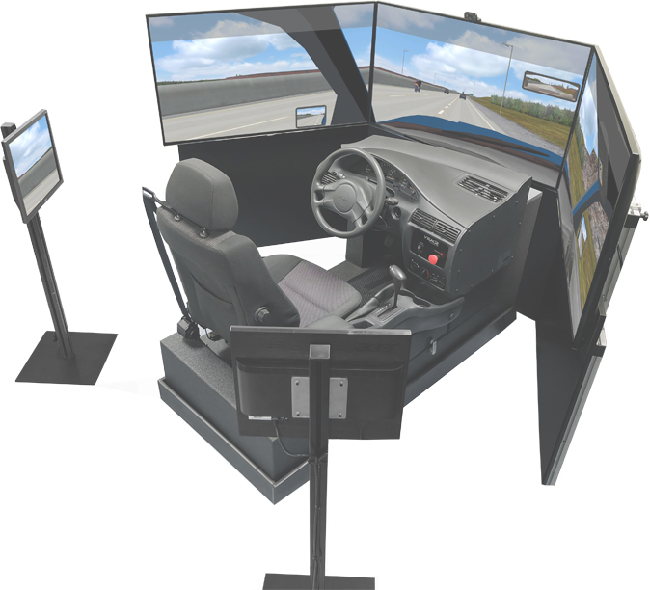
Experimental Setup
Components of the Experimental Setup
The study utilized the Carnetsoft Driving Simulator to replicate real-world driving conditions.
Participants wore the E4 Empatica Wristband to collect physiological data, including electrodermal activity (EDA), heart rate (HR), and body temperature.
Six driving scenarios were designed to include specific latent hazards, enhancing the ecological validity of the experiment.

Slide 6


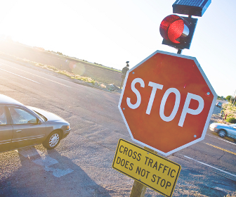
Distraction Scenarios
Work Zone Scenario
Curve Scenario
Stop-Controlled Intersection
Participants navigated a two-lane highway at 110 km/h, facing a hidden worker behind a bulldozer in the emergency lane.
Simulated suburban road with trucks parked along a curve, hiding a pedestrian, requiring vigilance at 80 km/h.
Urban intersection with a stop sign obscured by vegetation, testing hazard detection and verbal task performance at 50 km/h.

Slide 7
Post-Drive Evaluation
After completing the driving scenarios, participants filled out the NASA TLX questionnaire to assess their subjective workload.
The NASA TLX is a multi-dimensional rating technique measuring mental demand, physical demand, temporal demand, perceived performance, effort, and frustration.
The data collected from the questionnaires were analyzed using various statistical tests to understand the impact of cognitive distractions on subjective workload.

Slide 8
Physiological Responses: Baseline vs Distracted
Physiological Responses During Baseline and Distracted Conditions
Increased EDA and HR indicate heightened arousal during distraction, while temperature shows stress-induced cooling.

Slide 9


Impact of Driving Experience
Physiological Responses and Driving Experience
Key Findings from ANOVA
Driving experience significantly impacts HR and temperature, but not EDA.
Less experienced drivers show higher HR and EDA values during distractions.
This suggests greater physiological reactivity to cognitive distractions among novice drivers.
ANOVA results: HR (F = 2997.65, p < 0.001) and Temp (F = 14207.6, p < 0.001) show significant effects.
EDA shows no significant difference by experience (F = 1.226, p = 0.272).
Greater driving experience correlates with lower physiological arousal during distractions.

Slide 10
Motion Sickness
Susceptibility :
Objective :Investigate physiological changes linked to motion sickness susceptibility under cognitive load.
Key Finding: Participants with higher MSSQ (Motion Sickness Susceptibility Questionnaire) scores showed notable physiological responses:
Increased Electrodermal Activity (EDA): Indicates heightened sympathetic nervous system activation.
Decreased Body Temperature: Suggests altered autonomic control.
Statistical Analysis:
Effect of MSSQ on EDA:
ANOVA results: F=14.361,p=0.00028F = 14.361, p = 0.00028F=14.361,p=0.00028
Effect of MSSQ on Body Temperature:
ANOVA results: F=1219.03,p=5.47×10−51F = 1219.03, p = 5.47 \times 10^{-51}F=1219.03,p=5.47×10−51
Implications: Higher MSSQ scores are linked to greater physiological stress during cognitive tasks.
Need for Interventions: These findings highlight the importance of developing strategies to mitigate physiological stress in individuals prone to motion sickness.

Slide 11
Correlation Analyses
Driving Experience vs HR
Spearman's correlation analysis showed a significant negative correlation between driving experience and heart rate (rs = -0.45398, p = 0.00253). This suggests that more experienced drivers tend to have lower heart rates during distraction.
MSSQ vs Temperature
The correlation between MSSQ scores and temperature was negative (rs = -0.19740, p = 0.21112). Higher MSSQ scores were associated with lower body temperatures, indicating increased physiological stress among those more prone to motion sickness.
Experience vs EDA
While the correlation between driving experience and electrodermal activity was not statistically significant (rs = -0.13097, p = 0.40839), there was a trend suggesting that more experienced drivers exhibited lower EDA levels during distraction.

Slide 12
Workload Analysis
ANOVA Results
Additional Findings
Mental demand significantly higher during distraction (F=58.64, p<.001).
Physical demand increased under distraction (F=5.37, p=.023).
Temporal demand higher when distracted (F=72.68, p<.001).
Performance decreased with distraction (F=26.23, p<.001).
Effort and frustration levels rose during distraction (F=44.09, p<.001; F=18.04, p<.001).
Overall workload significantly higher during distraction tasks.

Slide 13
Conclusion
1
2
3
Cognitive distractions significantly increase physiological arousal and perceived workload in young drivers, affecting their driving performance and safety.
Individual differences, such as driving experience and motion sickness susceptibility, play a crucial role in how drivers respond to cognitive distractions.
Personalized interventions tailored to individual driver characteristics are essential for enhancing road safety and mitigating the negative impacts of cognitive distractions.

Slide 14
References
Ahmadi, N., Sasangohar, F., Nisar, T., Danesh, V., Larsen, E., Sultana, I., & Bosetti, R. (2022). Quantifying Occupational Stress in Intensive Care Unit Nurses: An Applied Naturalistic Study of Correlations Among Stress, Heart Rate, Electrodermal Activity, and Skin Temperature. Human Factors, 64(1), 159–172. https://doi.org/10.1177/00187208211040889
Ba, S., & Hu, X. (2023). Measuring emotions in education using wearable devices: A systematic review. Computers & Education, 200, 104797. https://doi.org/10.1016/j.compedu.2023.104797
WHO. (2023). Global status report on road safety 2023. https://www.who.int/teams/social-determinants-of-health/safety-and-mobility/global-status-report-on-road-safety-2023
Qi, Y., Vennu, R., & Pokhrel, R. (2020). Distracted Driving: A Literature Review. FHWA-ICT-20-004. https://doi.org/10.36501/0197-9191/20-005
Cunningham, M. L., Regan, M. A., & Imberger, K. (2020). Understanding driver distraction associated with specific behavioural interactions with in-vehicle and portable technologies. Journal of the Australasian College of Road Safety, 28(1), 27–40. https://doi.org/10.3316/informit.695045538098973

Slide 15
-Thank you-

